Slide 1
AI 课程教师介绍
陆博士:
中国人。汉堡大学博士，师从马克斯普朗克物质结构与分子动力学研究所的Director Miller 教授。现就职于 欧盟投资超过十亿欧元的欧洲X射线自由电子激光 (European XFEL)。曾经先后毕业于国内985高校，及德国精英大学Karlsruhe Institute of Technology (KIT)，有超过十年学术经验。
欧博士:
德国人。先后毕业于KIT及MIT，有超过20年学术经验，在各大世界顶级刊物发表论文上百篇，是多个世界顶级刊物，如Science, Nature的审稿人，也是多个物理学国际会议的组织者及分会主席。

Slide 2
Tentative Schedule for the AI Lecture
Week | Contents
1 | Introduction to artificial intelligence (AI) and maching learning (ML)
2 | Learn to Program: The Fundamentals (I)
3 | Learn to Program: The Fundamentals (II)
4 | Learn to Program: The Fundamentals (III)
5 | Learn to Program: The Fundamentals (IV)
6 | Python Basics
7 | Matlab Basics
8 | ML Algorithms (I)
9 | ML Algorithms (II)
10 | Explore ML with a Real Modelling Practice

Slide 3


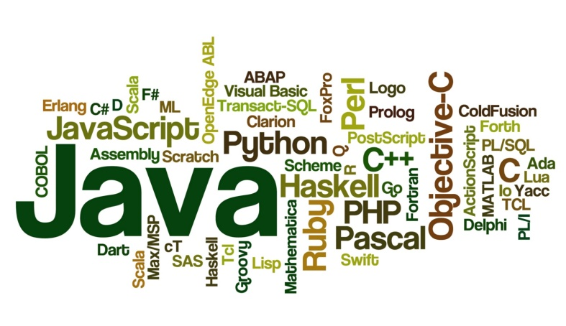
Self-introduction
Could you please introduce yourself?
What is your expectation of the lecture?
Which programming language have you learned in school?

Slide 4
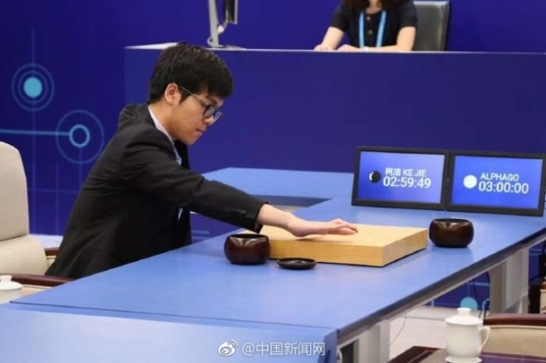
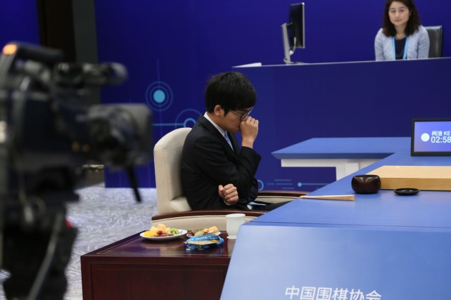
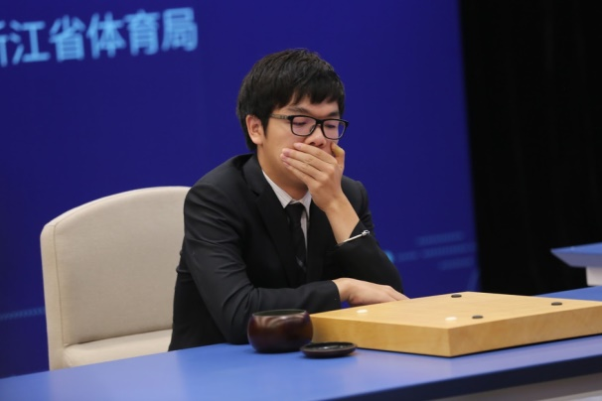
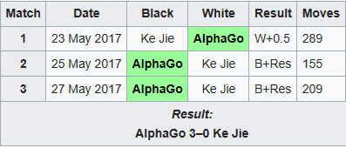
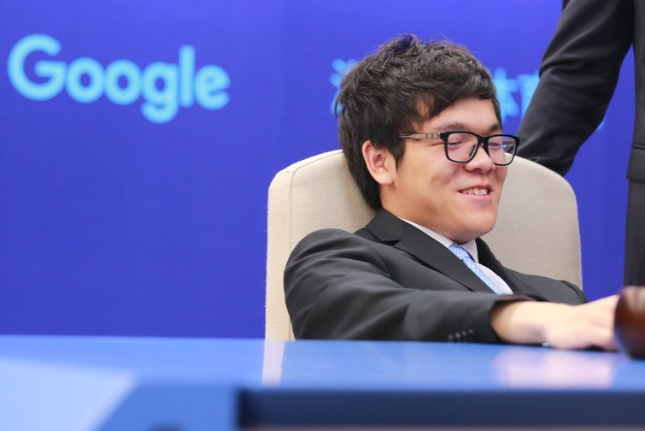
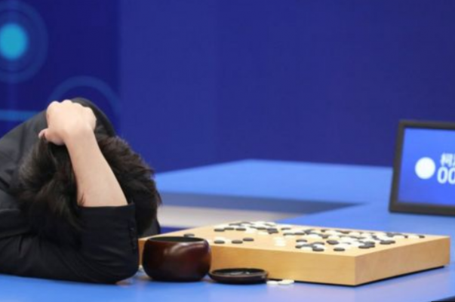
AlphaGo versus Ke Jie
confidence
anxiety
fear
hope
heartbreak

Slide 5
Discerning intelligence
Learning: Having the ability to obtain and process new information.
Reasoning: Being able to manipulate information in various ways.
Understanding: Considering the result of information manipulation.
Grasping truths: Determining the validity of the manipulated information.
Seeing relationships: Divining how validated data interacts with other data
Considering meanings: Applying truths to particular situations in a manner consistent with their relationship
Separating fact from belief: Determining whether the data is adequately supported by provable sources that can be demonstrated to be consistently valid.

Slide 6
Multiple intelligence
Type | Human Tools | Simulation Potential
Visual-spatial | Models, graphics, charts, charts, photographs, drawings, 3-D modeling, video, TV, and multimedia | Moderate
Bodily-kinesthetic | Specialized equipment and real objects | Moderate to High
Creative | Artistic output, new patterns of thought, inventions, new kinds of musical composition | None
Interpersonal | Phone, audio video and computer conferencing, writing, email | Low to moderate
Intrapersonal | Books, creative material, diaries, privacy, and time | None
Linguistic | Games, multimedia, books, voice recorders, and spoken words | Low
Logical-mathematical | Logic games, investigations, mysteries, and brain teasers | High

Slide 7
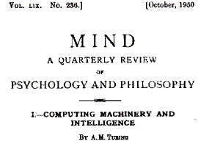
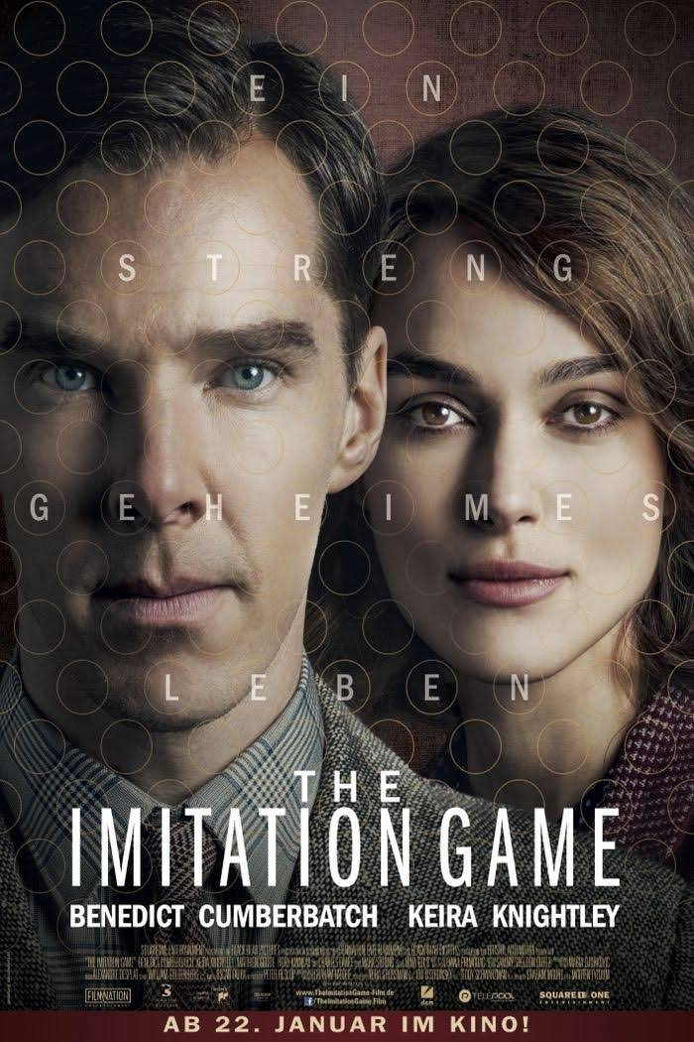
4 ways to define AI
Acting humanly:
When a computer acts like a human, it best reflects the Turing test, in which the computer succeeds when differentiation between the computer and a human isn't possible.
https://www.turing.org.uk/scrapbook/test.html

Slide 8
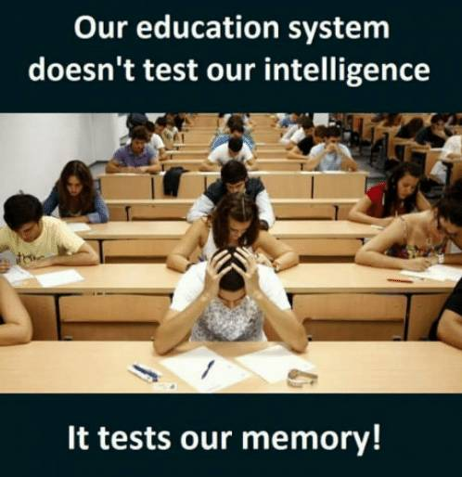
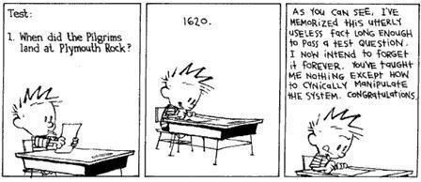
4 ways to define AI
Thinking Humanly:
When a computer thinks as a human, it performs tasks that require intelligence (as contrasted with rote procedures) from a human to succeed.

Slide 9
4 ways to define AI
Cognitive modeling approach:
Introspection: detecting and documenting the techniques used to achieve goals by monitoring one’s own thought processes.
Psychological testing: Observing a person’s behavior and adding it to a database of similar behaviors from other persons given a similar set of circumstances, goals, resources, and environentental conditions (among other things).
Brain imaging: Monitoring brain activity directly through various mechanical means, such as Computerized Axial Tomography (CAT), Positron Emission Tomography (PET), Magnetic Resonance Imaging (MRI), and Magnetoencephalography (MEG).

Slide 10
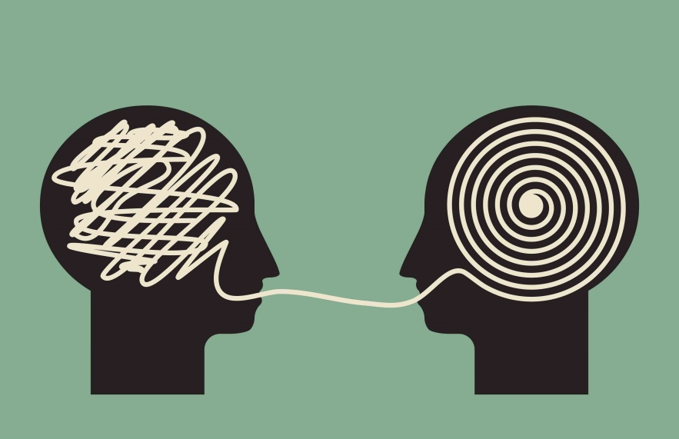
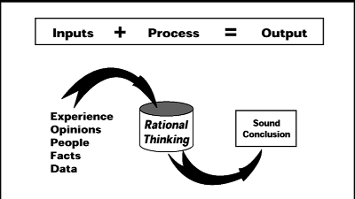
4 ways to define AI
Thinking rationally:
Studying how humans think using some standard enables the creation of guidelines that describe typical human behaviors. A person is considered rational when following these behaviors within certain levels of deviation. A computer that thinks rationally relies on the recorded behavior to create a guide as to how to interact with an environment based on the data at hand.
Creation of a baseline technique for solving a problem, which would then be modified to actually solve the problem

Slide 11
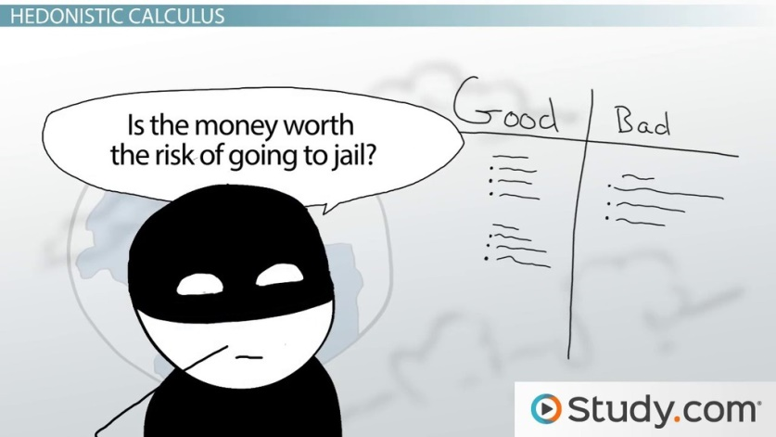
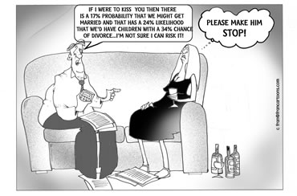
4 ways to define AI
Acting rationally:
A computer that acts rationally relies on the recorded actions to interact with an environment based on conditions, environmental factors, and existing data.
Rational acts provide a baseline upon which a computer can begin negotiating the successful completion of a goal.

Slide 12
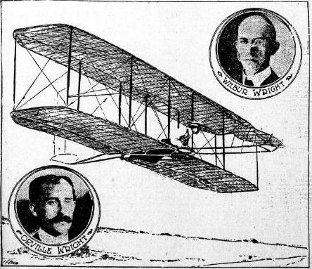

Brief history of AI
Starting with symbolic logic at Dartmouth
The biggest problem with these early attempts is that we don’t understand how humans reason well enough to create a simulation of any sort.

Slide 13
Brief history of AI
Continuing with expert systems (e.g. grammar check)
Rule-based: use if---then states to based decisions on rules of thumb
Frame-based: use databases organized into related hierarchies of generic information called frames
Logic-based: rely on set theory to establish relationships
A problem with expert system is that they can be hard to create and maintain.

Slide 14
Brief history of AI
Overcoming the AI winters
AI winter: a period of reduced funding in the development of AI (roller-coaster)
AI is currently in a new hype phase because of machine learning, a technology that helps computers learn from data. It does not depend on a human programmer to set operations, but rather deriving them directly from examples that show how the computer should behave.
The most successful machine learning algorithms is deep learning, which is a technology that strives to imitate the human brain. Deep learning is possible because of the availability of powerful computers, smarter algorithms, large datasets produced by the digitalization of our society, and huge investments from businesses such as Google, Facebook, Amazon, and others that take advantage of this AI renaissance for their own businesses.

Slide 15
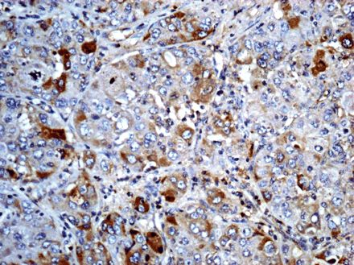
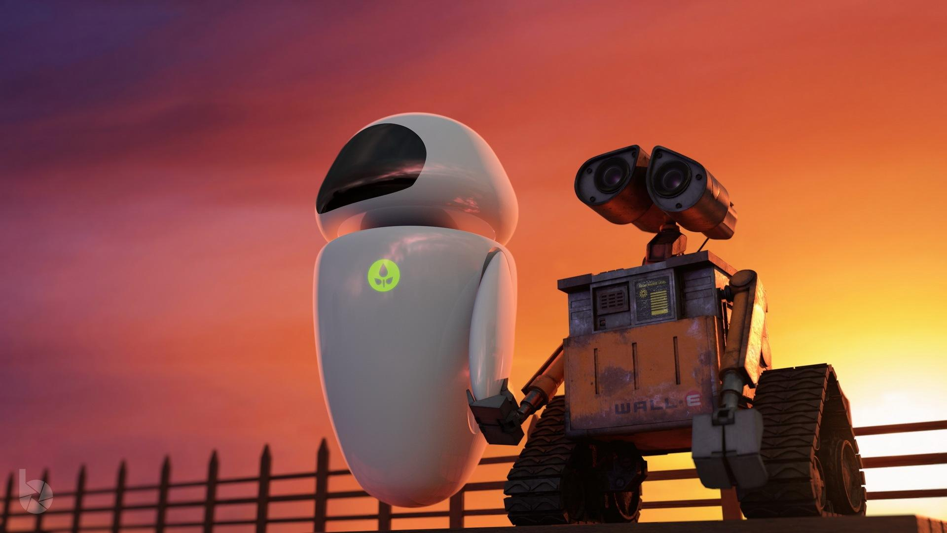
AI applications
Fraud detection
Resource scheduling
Complex analysis
Automation
Customer service
Safety systems
Machine efficiency

Slide 16

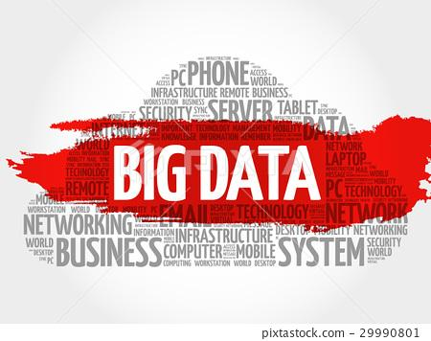
Connecting AI to the underlying computer
The size of the computing system is directly proportional to the amount of work you expect the AI to perform.
The application can also vary in size, complexity, and even location
The more complex the date, the more you can obtain from it, but the more you need to manipulate it as well.

Slide 17
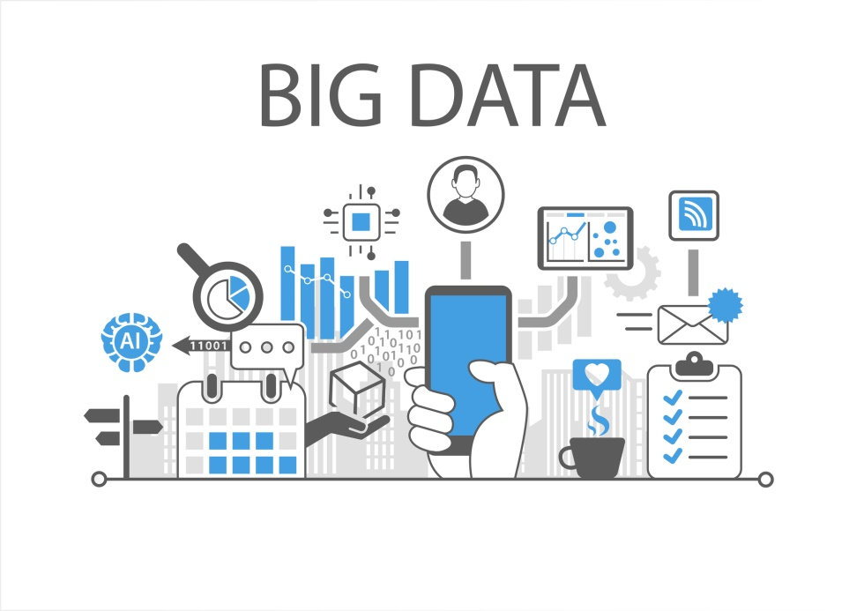
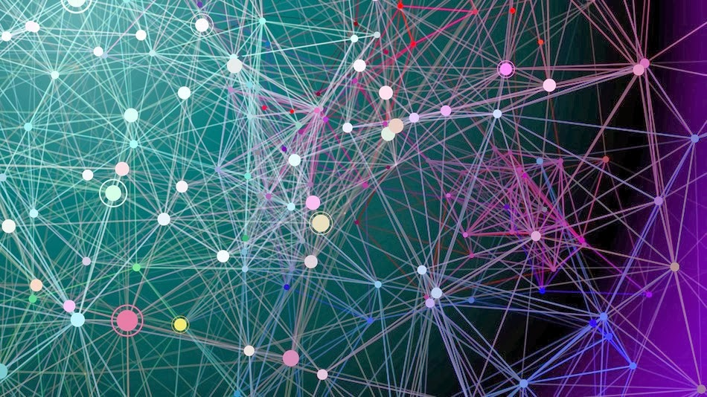
Defining the role of data
Big data: large and complex amounts of computer data, so large and intricate that applications cannot deal with the data by using additional storage or increasing computer power.

Slide 18
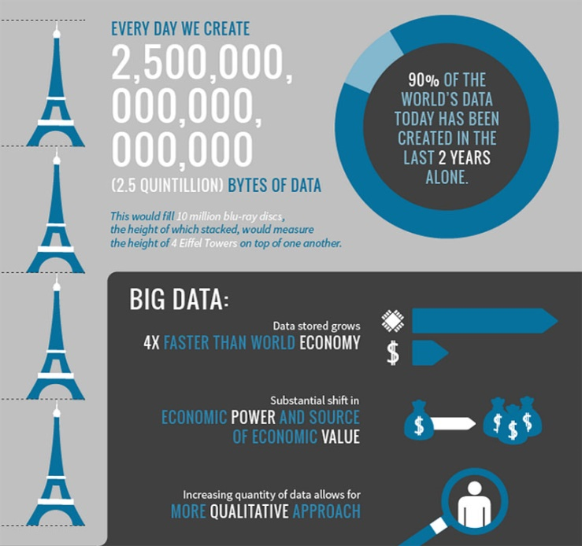
The source of big data
Internet: generates and distributes new data in large amounts.
Current daily data production: ~ 2.5 quintillion (with 18 zeros) bytes
All this data is related to human activities, feelings, experiences, and relations.
Roaming through this data, an AI can easily learn how reasoning and acting more human-like works.

Slide 19

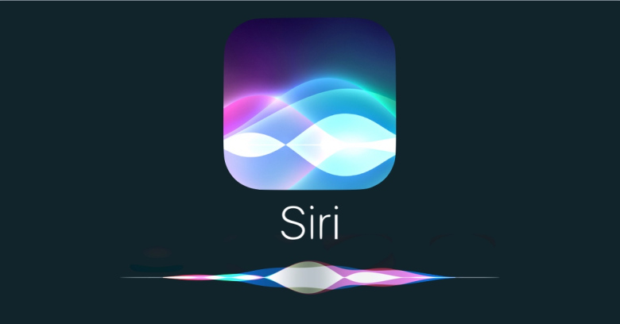
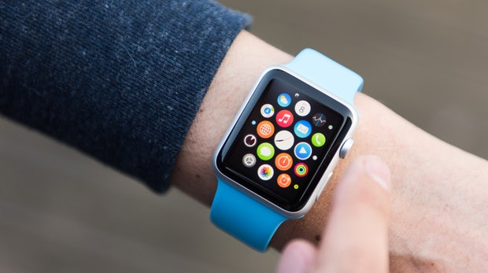
Examples of big data
Large repositories of faces and expressions from photos and videos posted on social media websites, such as Facebook, Youtube. Google provide information on gender, age, feelings and possibly sexual preferences, political orientations, or IQ.
Privately held medical information and biometric data from smart wathes, which measure body data such as temperature and heart rate during both illness and good health.
Datasets of how people relate to each other and what drives their interest from sources such as social media and search engines.
Information on how we speak is recorded by mobile phones.

Slide 20
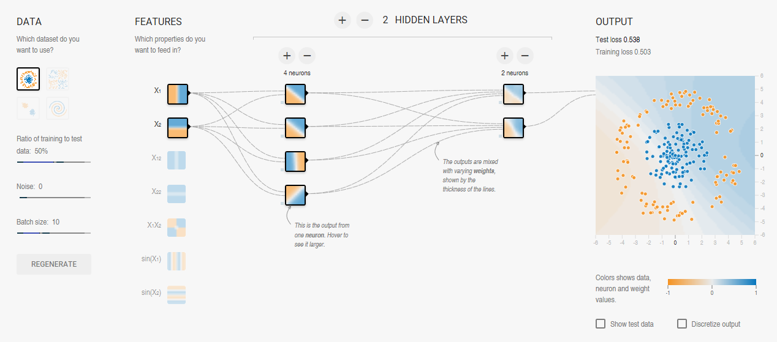
AI algorithms
AI algorithms have passed from simple algorithms to symbolic reasoning based on logic and then to expert systems.
In recent years, they became neural networks and, in their most mature form, deep learning.
Data turned from being the information processed by predetermined algorithms to becoming what molded the algorithm into something useful for the task.
Data turned from being just the raw material that fueled the solution to the artisan of the solution iteself.

Slide 21
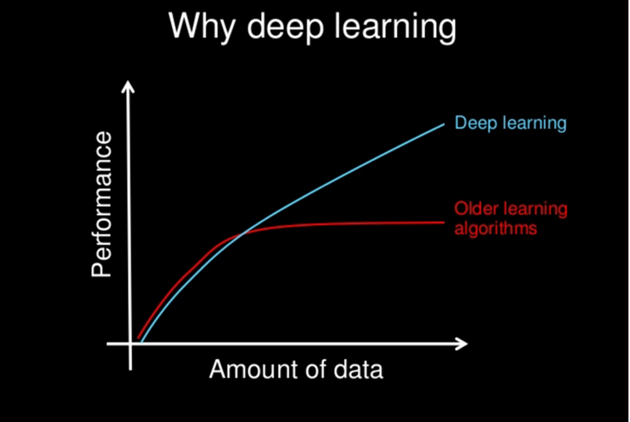
AI algorithm v.s. Older algorithms

Slide 22

Take an example…
A shared photo of your cat on Instagram has become increasingly useful not simply just because of its affective value — depicting your cute little cats — but because it could become part of the learning process of an AI discovering more general concepts, such as what characteristics denote a cat, or understanding what defines cute.

Slide 23
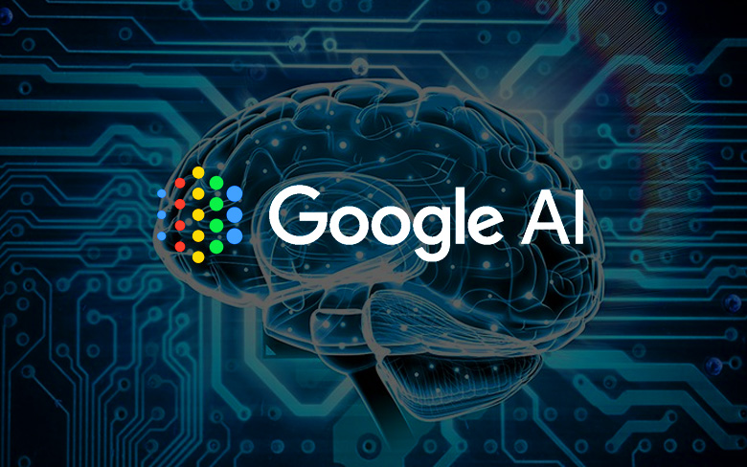
Take another example on a larger scale
Google feeds it algorithms from freely available data, such as the content of websites or the text found in publicly available texts and books. Goodgle spider software crawls the web, jumping from website to website, retrieving web pages with their content of text and images. Even if Google gives back part of the data to users as search results, ti extracts other kinds of information from the data using its AI algorithms, which learn from it how or achieve other objectives.

Slide 24
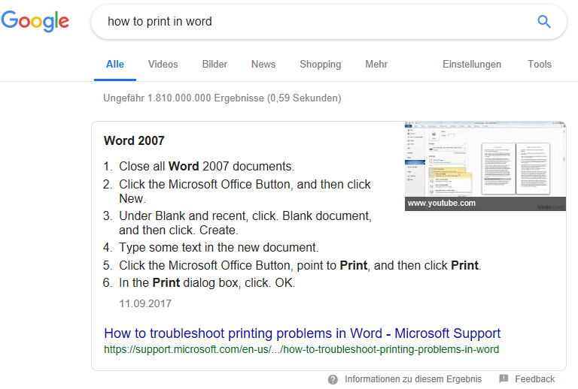
Take another example on a larger scale

Slide 25

Feedbacks

